Slide 1
Reading and Writing For Academic Purposes (A)
Introduction to the course
and to the IMRD Framework

Slide 2
Reading and Writing For Academic Purposes (A)
Russell w. a. Burgess
Course Code: 14201082
Office Hours: Thursday 1:00 – 3:00, 明理楼208D
E-Mail: rwaburgess@mail.tsinghua.edu.cn

Slide 3




Slide 4

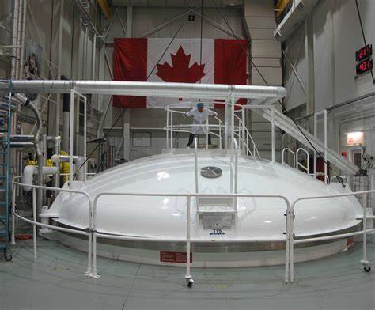
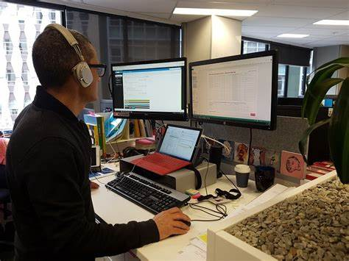
Technical Writer
Cooperative Education (Co-op)

Slide 5
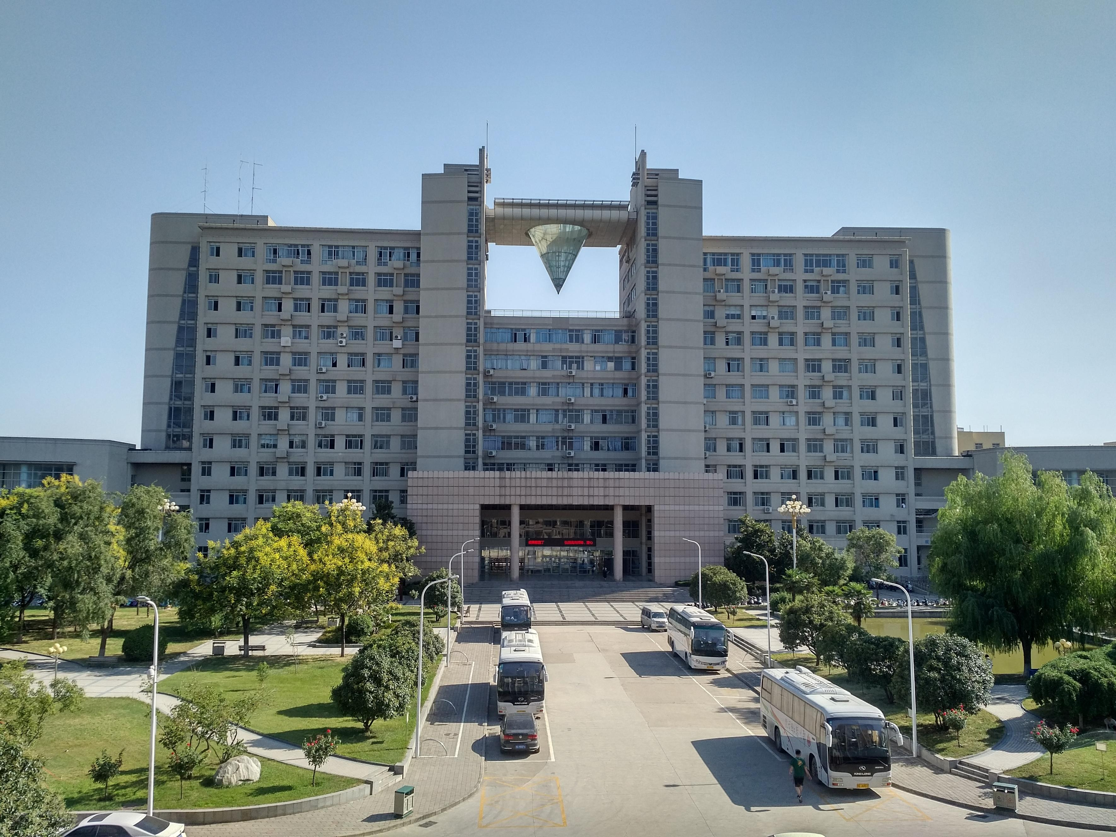
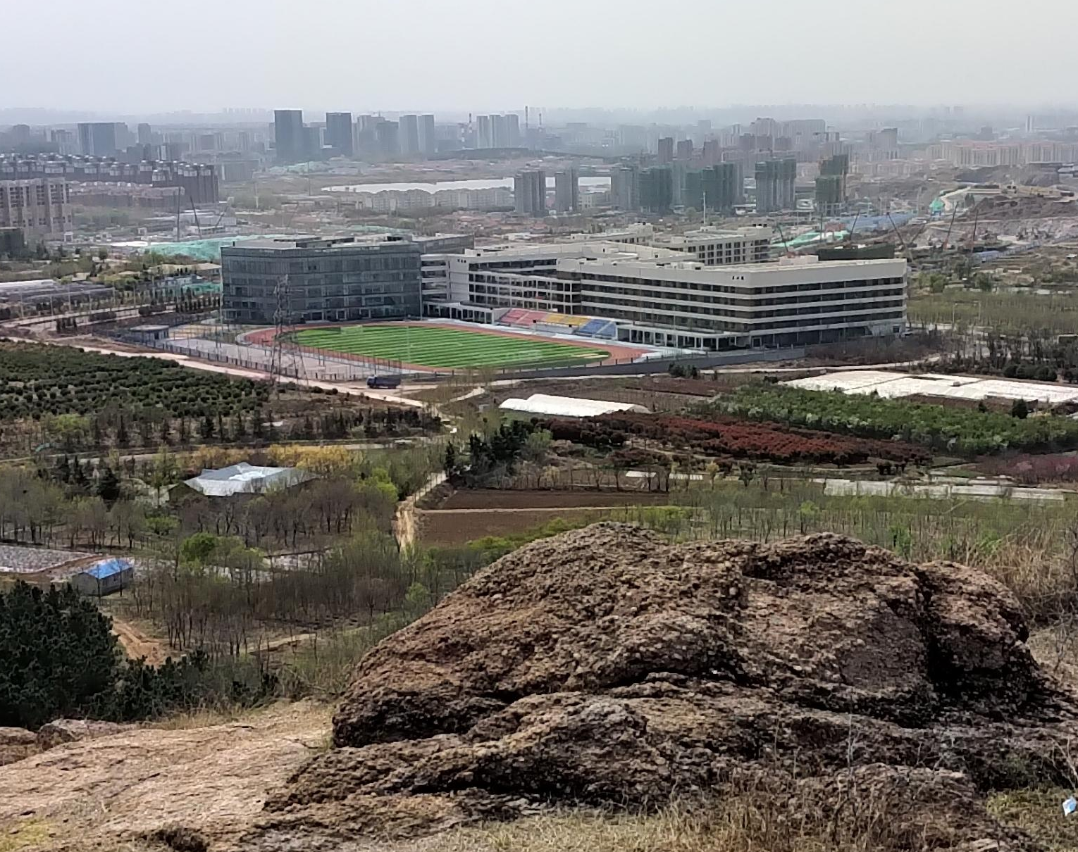

Slide 6
Introduction to The Course
This course is intended to teach you skills needed to complete academic research papers, and help your general ability to read and write academically.

Slide 7
Attendance
Attendance is compulsory. Starting next class, there will be a sign-in sheet passed around each class, and online students should use their name as their account.
If you miss classes without notifying your teacher, you will lose 1 point off your final grade for each class missed. Please provide an explanation for the evidence (doctor’s note, official form, etc.) to avoid losing any points.
You are still responsible for assignment deadlines. If you know you will have to miss class for reasons relating to university activities, you should ask for any assignments due and hand in the work in advance.

Slide 8
Homework and Assignments
All homework/assignments must include your name & student number in the filename or document (to make sure they are marked)
Assignments and homework will be submitted on the course learning platform (learn.tsinghua.edu.cn)
Students will not be reminded about missing assignments or homework – you are responsible for your own deadlines
Late assignments should be handed in via e-mail (not wechat), and will be penalized appropriately

Slide 9
Participation
While this isn’t a speaking class, there is still participation – to get participation marks, you should take part in class discussions, answer questions when asked, take opportunities to read, and work together on group activities and assignments.
Correct answers are not needed for class participation: any speaking is better than silence, so just do your best!
I’ll explain the scoring system next class

Slide 10
Phones
While cellphones will be allowed for looking up words, spelling, or information, they are not to be used for gaming or other distractions!
Phones or other internet devices will also be used for all our in-class quizzes, so make sure to have them on quiz days
Anyone found using their phone improperly will be warned. Anyone disturbing the class, or who has been warned more than once, may be asked to place their phone at the front until the end of class.

Slide 11
Course Assessment
Class participation: 10%
Assignments: 30%
Quizzes: 20%
Final paper: 40%

Slide 12
Communication
There will be a class WeChat group – you should use English in it (more practice is always better)
My email is rwaburgess@mail.tsinghua.edu.cn
Emails should always include you name, student number, and class so I know who you are

Slide 13
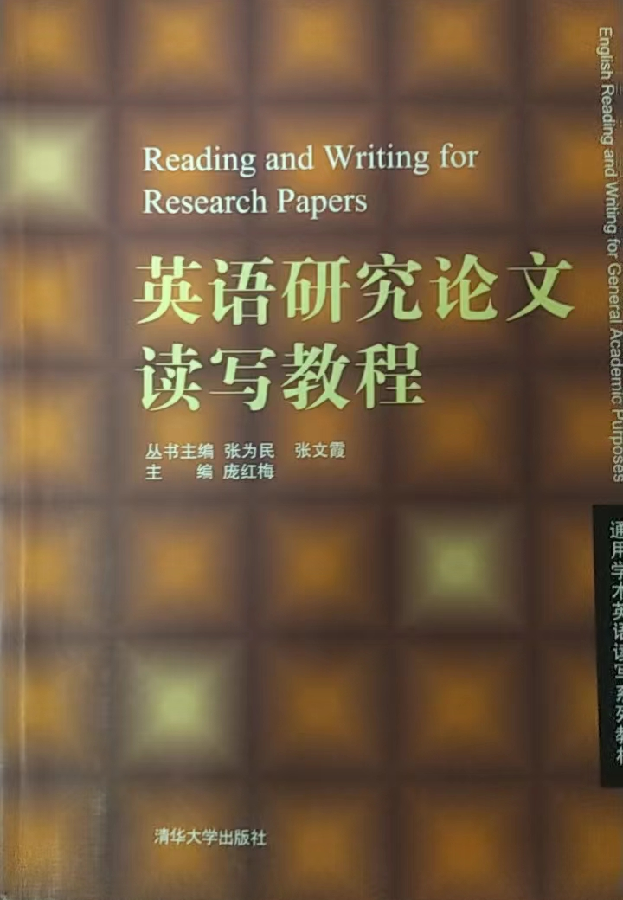
Textbook

Slide 14
Some questions to start
What is your major?
What kind writing have you done, in either Chinese or English? What format was it? (Essays, novels, letters, etc.)

Slide 15
Writing
What was your writing process? What do you think about first?
Why are there different kinds of writing?

Slide 16
Writing is Writing
Whether Academic English, fiction, or news media, we always want to think about two things when writing:
Purpose
Audience

Slide 17
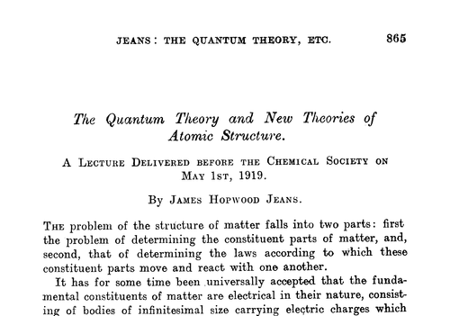
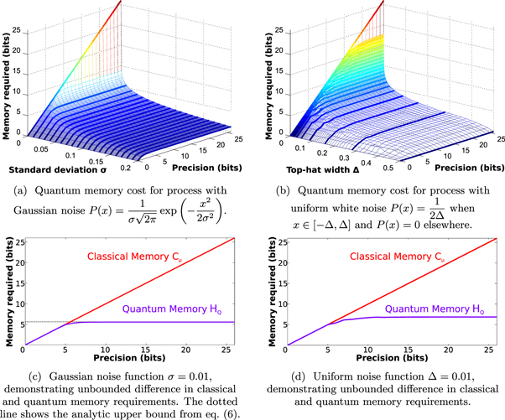
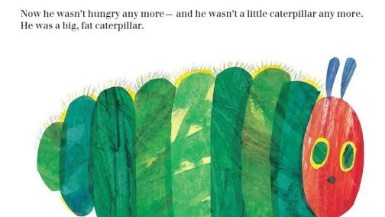
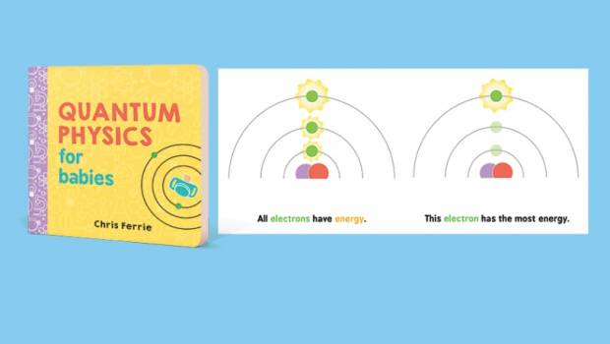
Purpose Audience | Tell A Story | Teach Quantum Theory
Research Scientists | “A hundred and fifty years before, when the parochial disagreements between Earth and Mars had been on the verge of war, the Belt had been a far horizon of tremendous mineral wealth beyond viable economic reach, and the outer planets had been beyond even the most unrealistic corporate dream.”
Children

Slide 18
Research Papers & Scientific Journals
So back to the subject of research….
Who is the audience of a research paper?
What is the purpose? What are we trying to do?

Slide 19
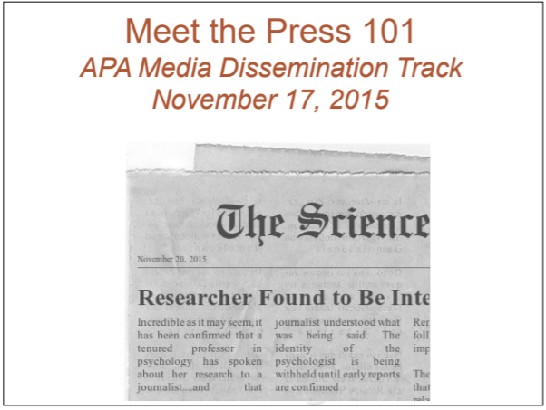
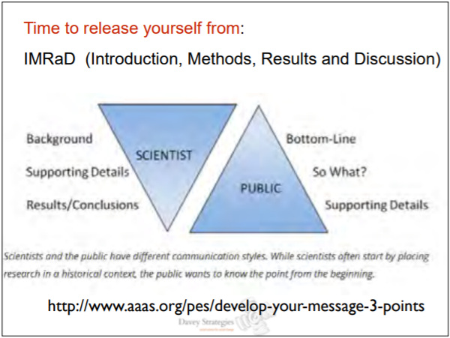
Specific Purpose and Specific Audience
https://www.apa.org/pi/about/public-messages.pdf

Slide 20
Research Papers & Scientific Journals
The scientific method is about testing and replication
Theory comes from observation, and is tested through repeated experimentation
Observation
Hypothesis
Testing
Theory

Slide 21
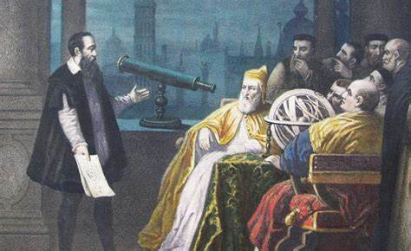
Research Papers & Scientific Journals
Academic studies, research papers, and scientific journal articles are a key part of the scientific method
Papers and articles are instructions that other researchers can use to replicate the studies, either proving or disproving the hypothesis
They can also be used to help others design their own research projects to build on the research
And of course, this is the main way that new discoveries are shared with the world

Slide 22
Different Kinds of Research
Empirical
Based on things you can observe or measure
If A happens → B happens
Lab experiments repeated over and over
Theoretical
How likely will A happen?
Related to ideas
Look at existing data and make a theory about the patterns (no experiment)

Slide 23
Different Kinds of Research
Quantitative Research | Qualitative Research
Predominant in science, medicine, and engineering but can be found in any field Usually consists of numerical data and measurements, and can include statistical analysis Seen as more objective | Common in arts and social science Involves gathering and interpreting non-numerical data, such as interviews, surveys, or observation Seen as more subjective
Do you hurt? Y/N
How does pain make you feel?

Slide 24
What do we need?
We know our purpose and audience: to share the findings of our completed research with other researchers, to allow them to either confirm our hypothesis by repeating the experiment, or to use our research to help their own
What kind of content do you think should we include in a research paper?

Slide 25
The IMRD Framework
The norm, and most common structure, for original research papers. The template contains 4 main sections:
Introduction
Methods
Results
Discussion
Introduction
Methods
Results
Sometimes also called IMRaD
Discussion

Slide 26
IMRD Framework
IMRD = major headings/sections in a paper
Introduction – why is your research important
Methods – how did you do it
Results – what did you find
Discussion – what does it mean
The IMRD framework is often used in most scientific and research areas

Slide 27
IMRD framework
It can be used for may different kinds of studies:
Experiments
Questionnaires and surveys
Interviews
Observations
Secondary research (books, journals, magazines, etc.)

Slide 28
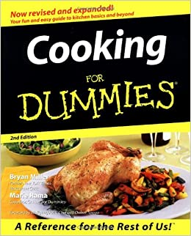
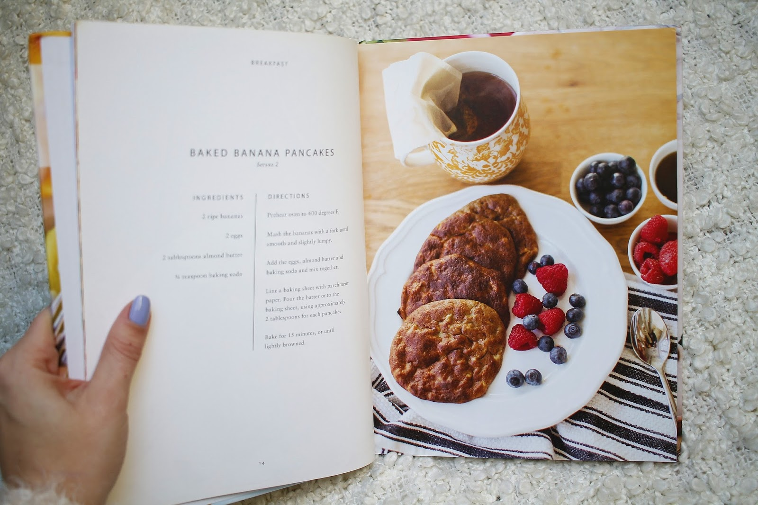
It’s like a cookbook for science

Slide 29
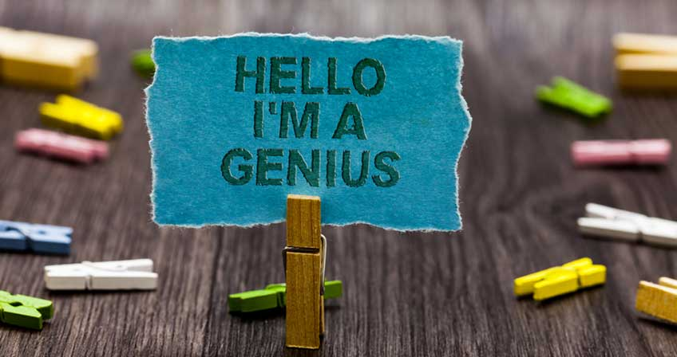
Introduction
Research problem
Literature review – what did other people find? (previous research)
Gaps in research
Hypothesis – what results do you think you will get
Summary of research
Enough information given to the readers – they don’t have to do extra reading to understand your topic
Do not hide facts

Slide 30
The Introduction
Just like all writing, a research paper should start with an introduction answering the question why:
Why is this a valid field of research?
Why was this particular research undertaken?
Why was this paper written?
Why should you be reading this paper?
Why should this research be continued or replicated?
The introduction should also give an overview of the subject, to bring the reader up to speed on what will be discussion, including defining any key terms and covering any relevant existing research.

Slide 31

Methods
How did you do your research?
Describe the steps so someone else can follow it and do the same research
This is different for every field, but try to be as detailed as possible (don’t include irrelevant information)
Who/what is in the research?
What did you do?
What did you look for?
If your methods are used by many others, you can just use a reference

Slide 32
Methods / Methodology
This is the “recipe” for the research design, and should answer the question How:
How did the author conduct their study?
How did the author decide what variables were relevant?
How did the author collect and analyze their data?
How could I conduct this same study?

Slide 33

Results
Data – what did you find?
Charts
Graphs
Tables
Quotes
Build up to a conclusion, but don’t give any analyses yet

Slide 34
Results
This is where the data can be found, both raw and processed, and should answer the question What:
What raw data did we collect?
What data did we get from analyzing the raw data according to our methodology?
What did we find?
Often the full raw data collection will be grouped together and placed in appendices at the end of the paper, but will be referenced in the main body

Slide 35
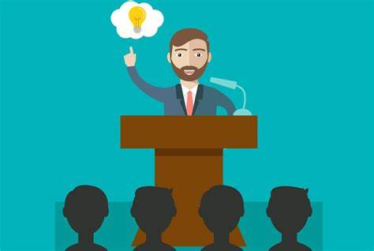
Discussion
Summarize the results
What you can learn from the data
What new knowledge did you find
How does your data compare to other people’s findings
Limitations and room for improvement (don’t make your paper sound bad)
Directions for future research
Conclusions – summary/closing statement

Slide 36
Discussion
This section should answer the larger question So What:
The results show X. So what?
The results are similar/different to existing studies. So what?
The methodology worked or did not work. So what?
So what was the point of this paper?
So what do we as researchers do next?

Slide 37
Summary (we’ll come back to these)
Part | Question | Content
Introduction | Why? | Research context / What is this field? Why this study?
Methods | How? | Data collection methods Data processing methods
Results | What? | What raw data was collected? What were the results of data processing?
Discussion | So what? | Significance (or not) of the results Research results in the context of existing research Methodology & Limitations Conclusion & Further study

Slide 38

Why do we still write research papers?
What is the point of this class?

Slide 39
Writing and Large Language Models (LLMs)
LLMs like ChatGPT exist now – so while the content of this course is still necessary, depending on how the future plays out, it may need to be applied differently
LLMs are called AI, but they are a very specific AI geared to language – they reproduce documents with good language based on existing knowledge
LLMs have been known to “hallucinate” text, which means that while the language may be good, the ideas or logic may be incorrect or even completely fabricated – not good for research papers

Slide 40


Example
Early in 2023, there was a civil court case in the US between a man, Roberto Mata, alleging injuries on a flight (caused by the serving cart) and Avianca Airlines
Steven Schwartz, the lawyer for Roberto Mata submitted a document showing precedent for the case, which cited six other cases – all of which where completely made up and never happened
“A member of Mata’s law team then revealed he had used ChatGPT to conduct legal research for the court filing that referenced the cases and that the artificial intelligence tool assured him the cases were real.”

Slide 41
Roberto Mata v. Avianca Airlines
The lawyers for Avianca couldn’t find any of the fake cases in law libraries (because they were, of course, fake) so they asked the judge for more information
The judge asked Mata’s legal team – the paralegal asked ChatGPT to find the case documents and turned these over to the Avianca lawyers
What he didn’t realize is that ChatGPT had not searched and found real case files – it had just created them
When this was eventually found out, the judge was furious – wanted sanctions against the legal team

Slide 42

The Hybrid
LLMs like ChatGPT are genuinely good at generating natural language content and formatting that content into essays, powerpoints, articles etc.
LLMs are not good at generating logical arguments or conducting research – the content of their output is generic and sometimes completely fabricated
In the future, if you want to integrate using LLMs into your work, it will be best to use it as a tool, not a replacement – you will still need the language and formatting knowledge to proofread and correct LLM outputs, especially for formal academic papers

Slide 43
The Human Element
You will still need to perform tasks that LLMs are less effective at, like research and logical argumentation, and to fix up the final product – that’s where this course still comes in
This means you will need to learn to craft the LLM prompts needed to create accurately formatted works that integrate the research and arguments you want to include without hallucination – far more involved and detailed than “write a research paper”

Slide 44
Think of it this way
If you can use an AI to do all the work in a homework assignment, so can anyone else (like an employer) – but if you have the skills to produce the work yourself or work with the AI to produce high-quality, accurate work faster, that makes you more valuable

Slide 45
Plagiarism

Slide 46
Plagiarism
What is your definition of plagiarism?
What should you do to avoid plagiarism?

Slide 47
Which of the following would be considered as plagiarism?
Not providing a reference when you have used somebody’s idea.
Giving the reference but not using quotation marks when you take a sentence from another writer’s article.
Presenting the results of your own research.
Copying a few sentences from an article on the Internet without giving a reference.
Not giving a reference when you use commonly accepted ideas.

Slide 48
Do you think using AI is plagiarism?
Can you plagiarize an AI?

Slide 49

According to the Merriam-Webster online dictionary, to "plagiarize" means:
to steal and pass off (the ideas or words of another) as one's own
to use (another's production) without crediting the source
to commit literary theft
to present as new and original an idea or product derived from an existing source
“Plagiarize.” Merriam-Webster.com. Merriam-Webster. Accessed May 20, 2020. https://www.merriam-webster.com/dictionary/plagiarize.
© 2021 Turnitin LLC. All rights reserved.

Slide 50
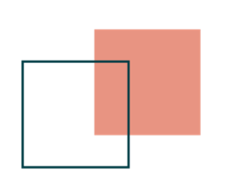
#1 Clone
Submitting another’s work, word-for-word, as one’s own
Source text
Student work
A Natural Setting: A History of Exploration and Settlement in Yosemite Valley
Since its first discovery by non-indigenous people in the mid-nineteenth century, Yosemite Valley has held a special, even religious, hold on the American conscience because its beauty makes it an incomparable valley and one of the grandest of all special temples of Nature. While Yosemite holds a special grip on the western mind, perceptions about the Valley have evolved over time due to changing politics, migration patterns and environmental concerns as man has become more attuned to his relationship and impact on nature.
A Natural Setting: A History of Exploration and Settlement in Yosemite Valley
Since its first discovery by non-indigenous people in the mid-nineteenth century, Yosemite Valley has held a special, even religious, hold on the American conscience because its beauty makes it an incomparable valley and one of the grandest of all special temples of Nature. While Yosemite holds a special grip on the western mind, perceptions about the Valley have evolved over time due to changing politics, migration patterns and environmental concerns as man has become more attuned to his relationship and impact on nature.
© 2021 Turnitin LLC. All rights reserved.
Notes:
Cloning is what most people think of when they think of plagiarism--using another’s work, word-for-word, as their own.
Examine the example and point out how both the source text and the student work are identical. The writer has essentially “cloned” the source text, then attempted to pass it off as their own. No attempt has been made to add quotation marks or references to the original source.
This is often the easiest type of plagiarism to identify because it’s so blatant and clear. However, many individuals often spend more time and create slightly more nuanced plagiarism than cloning, as we can see in the following types.

Slide 51
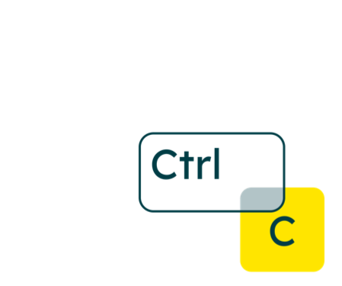
#2 Ctrl+C
Contains significant proportions of text from a single source without alterations
Source text
Student work
A Natural Setting: A History of Exploration and Settlement in Yosemite Valley
Since its first discovery by non-indigenous people in the mid-nineteenth century, Yosemite Valley has held a special, even religious, hold on the American conscience because its beauty makes it an incomparable valley and one of the grandest of all special temples of Nature. While Yosemite holds a special grip on the western mind, perceptions about the Valley have evolved over time due to changing politics, migration patterns and environmental concerns as man has become more attuned to his relationship and impact on nature.
The Beautiful Yosemite Valley
From the time of its first discovery by non-indigenous people in the mid-nineteenth century Yosemite Valley has held a special, even religious, possession on the American conscience because its beauty makes it an incomparable valley and one of the grandest of all special temples of Nature. And Yosemite holds a special grip on the western mind, while perceptions about the Valley have evolved over time due to changing politics, migration patterns and environmental concern as man has become more attuned to his relationship and impact or nature.
© 2021 Turnitin LLC. All rights reserved.
Notes:
The Ctrl+C type of plagiarism is similar to Cloning in many ways, but instead of copying large chunks of text word-for-word, the writer adds or changes a few small words here and there. Overall, the majority of the text comes from a single source though.
Again, no attempt has been made to add quotation marks or references to the original source.
Words that are changed are usually ones that appear at the beginning of the sentences and have easy synonyms to make it appear as if the text is different enough from the original at a quick glance.

Slide 52

#3 Remix
Paraphrases from multiple sources, made to fit together
Source text
Student work
A Natural Setting: A History of Exploration and Settlement in Yosemite Valley
Since its first discovery by non-indigenous people in the mid-nineteenth century, Yosemite Valley has held a special, even religious, hold on the American conscience because its beauty makes it an incomparable valley and one of the grandest of all special temples of Nature. While Yosemite holds a special grip on the western mind, perceptions about the Valley have evolved over time due to changing politics, migration patterns and environmental concerns as man has become more attuned to his relationship and impact on nature.
An Untouched View A History of Settlement and Change in Yosemite Valley
The first non-natives to see Yosemite Valley were probably members of the mid-nineteenth century Joseph Walker Party, who crossed the Sierra Nevada from East to West. The first descriptions of Yosemite came almost 20 years later. From the start, the valley has been renowned for its natural beauty, and highly regarded as he center-piece of Yosemite National Park, attracting visitors from around the world. While Yosemite holds a special grip on the western mind, perceptions about the Valley have evolved over time due to changing politics, migration patterns and environmental concerns as man has become more attuned to their relationship and impact on nature.
© 2021 Turnitin LLC. All rights reserved.
Notes:
In the Remix type of plagiarism, writers begin to get a little bit fancier with their efforts of concealing their plagiarism. Rather than taking large chunks of text from one source, the writer takes information from multiple sources, paraphrasing the information and fitting it together to make it appear as if it all works together seamlessly.
It’s important to acknowledge that in this example, like the others, no credit is being given to the original sources.

Slide 53

#4 Aggregator
Includes proper citation to sources but the paper
contains almost no original work
Source text
Student work
A Natural Setting: A History of Exploration and Settlement in
Yosemite Valley
Since its first discovery by non-indigenous people in the mid-nineteenth century, Yosemite Valley has held a special, even religious, hold on the American conscience because its beauty makes it an incomparable valley and one of the grandest of all special temples of Nature. While Yosemite holds a special grip on the western mind, perceptions about the Valley have evolved over time due to changing politics, migration patterns and environmental concerns as man has become more attuned to his relationship and impact on nature.
A Natural Setting: A History of Exploration and Settlement in Yosemite Valley ¹
Yosemite Valley was first sighted by non-Indians in 1833 by Joseph Rutherford Walker and his group of explorers. ² Yosemite has a long and diverse cultural history that helped to shape the region, country, and even the world. ³ While Yosemite holds a special grip on the western mind, perceptions about the Valley have evolved over time due to changing politics, migration patterns and environmental concerns as man has become more attuned to their relationship and impact on nature. ⁴
1 Harrick, C. “A Natural Setting.” Nature and its Discontents 23.1 (1996) : 41-50. Print.
2 “History of Yosemite,” Yosemitegold.com Ace & Friends, n.d. Web. 24 Apr. 2012. <http://www.yosemitegold.com/yosemite/history.html>
3 “Yosemite National Park Cultural History,” Yosemitepark.com DNC Parks and Resorts at Yosemite, Inc., n.d. Web. 24 Apr. 2012. <http://www.yosemitepark.com/cultural-history.aspx>
4 Harrick, C. “A Natural Setting,” p. 41.
© 2021 Turnitin LLC. All rights reserved.
Notes:
In the Aggregator type of plagiarism, the writer includes proper and effective citations for all references to source material. However, the majority of the work is made up of source material and very little is original work by the writer.
When this type of plagiarism is seen, the writer should be encouraged to add their own thoughts when possible in order to create a balance between source material and original work.

Slide 54
Avoiding plagiarism
1 Manage your time during the researching and writing process wisely.
2 Employ effective research strategies.
3 Choose when to summarize, paraphrase, or quote information from your sources.
4 Provide proper citations for your paraphrased, quoted, or summarized information.
© 2021 Turnitin LLC. All rights reserved.
Notes:
Review these practical strategies for avoiding plagiarism with your students. Many of them likely came up during their brainstorming. Highlight any that are missing from that brainstorming discussion.
Distribute the Avoiding Plagiarism handout so students can have constant access to these strategies.
Hang the Avoiding Plagiarism poster in your classroom so it is visible to students at all times.
Reinforce all of these strategies in your classroom on a regular basis. The more commonplace they become, the more students will get in the habit of using them, rather than trying to incorporate them only around the big research paper time.

Slide 55
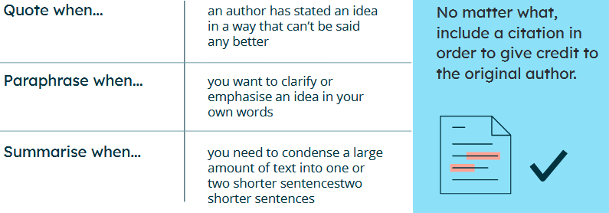

Slide 56
Practice A
Source text
Student work
There is no incongruity in the idea that in the very earliest period of man's habitation of this world he made a friend and companion of some sort of aboriginal representative of our modern dog, and that in return for its aid in protecting him from wilder animals, and in guarding his sheep and goats, he gave it a share of his food, a corner in his dwelling, and grew to trust it and care for it. Probably the animal was originally little else than an unusually gentle jackal, or an ailing wolf driven by its companions from the wild marauding pack to seeks shelter in alien surroundings.
There is no difference in the idea that in the very earliest
period of man's habitation of this world he made a friend
and companion of some sort of native representative of
our modern dog, and that in return for its help in
protecting him from wilder animals, and in guarding his
sheep and goats, he gave it a share of his food, a corner
in his home and grew to trust it and care for it. Probably
the animal was originally little else than an unusually
gentle jackal, or an ailing wolf driven by its companions
from the wild marauding pack to seek shelter in strange
surroundings.
Leighton, Robert. Dogs and All about Them. London: Cassell and Company, Ltd., 1910.
© 2021 Turnitin LLC. All rights reserved.
Notes:
Show source text and student writing. Educator should model a think aloud that identifies the characteristics of the writing (highlighting of similar text is available in animations). Demonstrate the thinking process of why or why not this example qualifies as plagiarism.
Be sure to begin to discuss ways that writers have or have not avoided plagiarism in these examples that will be covered in slide 23 so that there is a seamless transition into discussing the most effective ways to avoid plagiarism.
Answer: PLAGIARISM
Explanation: This example copies the majority of the source text while only attempting to modify a few key words throughout in order to seem less verbose. No citation is included, and overall, the writing attempts to pass off this text as original work.
*Note that all citations included in this presentation are written in Chicago style. Feel free to modify to better fit your institution’s preferred citation style.

Slide 57
Practice B
Source text
Student work
It is a significant circumstance when we come to
consider the probable origin of the dog, that there are
indications of his domestication at such early periods by so many peoples in different parts of the world. As we have seen, dogs were more or less subjugated and tamed by primitive man, by the Assyrians, Egyptians,
Phoenicians, Greeks, and Romans, as also by the ancient barbaric tribes of the western hemisphere. The important question now arises: Had all these dogs a common origin in a definite parent stock, or did they spring from separate and unrelated parents?
The origin of different types of dogs
can be a perplexing question. As
Leighton (1910) asks in Dogs and All
About Them, “Had all these dogs a
common origin in a definite parent
stock, or did they spring from
separate and unrelated parents?” (20).
Leighton, Robert. Dogs and All about Them. London: Cassell and Company, Ltd., 1910.
© 2021 Turnitin LLC. All rights reserved.
Notes:
Show source text and student writing. Educator should model a think aloud that identifies the characteristics of the writing (highlighting of similar text is available in animations). Demonstrate the thinking process of why or why not this example qualifies as plagiarism.
Be sure to begin to discuss ways that writers have or have not avoided plagiarism in these examples that will be covered in slide 23 so that there is a seamless transition into discussing the most effective ways to avoid plagiarism.
Answer: NOT PLAGIARISM
Explanation: This example uses the student’s own writing to introduce a quoted piece of material from the text and includes proper in-text citation for the section that was included.
*Note that all citations included in this presentation are written in Chicago style. Feel free to modify to better fit your institution’s preferred citation style.

Slide 58
Practice C
Source text
Student work
The name Mastiff was probably applied to any
massively built dog. It is not easy to trace the true
breed amid the various names which it owned.
Molossus, Alan, Alaunt, Tie-dog, Bandog (or
Band-dog), were among the number. The names
Tie-dog and Bandog intimate that the Mastiff
was commonly kept for guard, but many were
specially trained for baiting bears, imported lions,
and bulls.
The Mastiff is a type of dog that is
notoriously large and muscular. They
were often used as bait for large,
aggressive animals like bears, lions, and
bulls, and have been known through the
ages by names like Tie-dog or
Molossus. (Leighton 1910, 34)
Leighton, Robert. Dogs and All about Them. London: Cassell and Company, Ltd., 1910.
© 2021 Turnitin LLC. All rights reserved.
Notes:
Show source text and student writing. Educator should ask students for input as they think aloud as a class, identifying characteristics of the writing (highlighting of similar text is available in animations). Work together to determine why or why not this example qualifies as plagiarism.
Be sure to begin to discuss ways that writers have or have not avoided plagiarism in these examples that will be covered in slide 23 so that there is a seamless transition into discussing the most effective ways to avoid plagiarism.
Answer: NOT PLAGIARISM
Explanation: This example effectively paraphrases information from the original source text by rewording the information in a meaningful way. Notice that a citation is still included to acknowledge that the ideas, rather than the words themselves, come from a different source.
*Note that all citations included in this presentation are written in Chicago style. Feel free to modify to better fit your institution’s preferred citation style.

Slide 59
Textbook, Page VIII
Here’s the ORIGINAL text, from page 1 of Lizzie Borden: A Case Book of Family and Crime in the 1890s by Joyce Williams et al.:
The rise of industry, the growth of cities, and the expansion of the population were the three great developments of late nineteenth century American history. As new, larger, steam-powered factories became a feature of the American landscape in the East, they transformed farm hands into industrial laborers, and provided jobs for a rising tide of immigrants. With industry came urbanization the growth of large cities (like Fall River, Massachusetts, where the Bordens lived) which became the centers of production as well as of commerce and trade.

Slide 60
Is this a good paraphrase, or is it plagiarism? Why? You may discuss together.
The increase of industry, the growth of cities, and the explosion of the population were three large factors of nineteenth century America. As steam-driven companies became more visible in the eastern part of the country, they changed farm hands into factory workers and provided jobs for the large wave of immigrants. With industry came the growth of large cities like Fall River where the Bordens lived which turned into centers of commerce and trade as well as production.

Slide 61
Is this a good paraphrase, or is it plagiarism? Why? You may discuss together.
Fall River, where the Borden family lived, was typical of northeastern industrial cities of the nineteenth century. Steam-powered production had shifted labor from agriculture to manufacturing, and as immigrants arrived in the US, they found work in these new factories. As a result, populations grew, and large urban areas arose. Fall River was one of these manufacturing and commercial centers (Williams, 1).

Slide 62
Is this a good paraphrase, or is it plagiarism? Why? You may discuss together.
Fall River, where the Borden family lived, was typical of northeastern industrial cities of the nineteenth century. As steam-powered production shifted labor from agriculture to manufacturing, the demand for workers “transformed farm hands into industrial laborers”, and created jobs for immigrants. In turn, growing populations increased the size of urban areas. Fall River was one of these hubs “which became the centers of production as well as of commerce and trade” (Williams, 1).

Slide 63
Class Guidelines
Students will be expected to adhere to standards of academic honesty and integrity.
All assignments must be the student’s original work, and plagiarism will not be tolerated
There will be zero tolerance for deliberate infractions. The teacher reserves the right to discipline any student for academic dishonesty, in accordance with the general rules and regulations of the university.
Plagiarism doesn’t help in the long term. Even if plagiarism is not discovered, the more it is used, the more it is relied on. The goal of this course is to give you the skills and techniques you need for the future, not to get the highest mark.

Slide 64
Next Week
In your textbook, have a look at the first research paper for Unit 1, Exploring University Students’ Perceptions of Plagiarism: A Focus Group Study.
Next week we will go through this paper in more detail to demonstrate some of the sections we covered briefly today in more depth

Slide 65
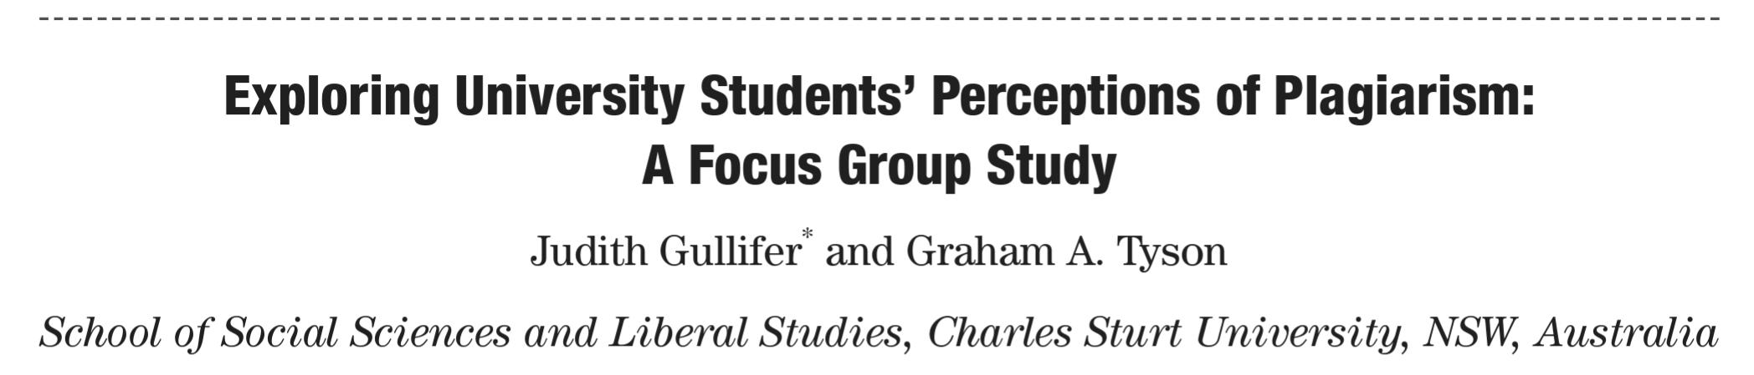

Slide 66
Summary
Part | Question
Introduction | Why?
Methods | How?
Results | What?
Discussion | So what?

